Slide 1
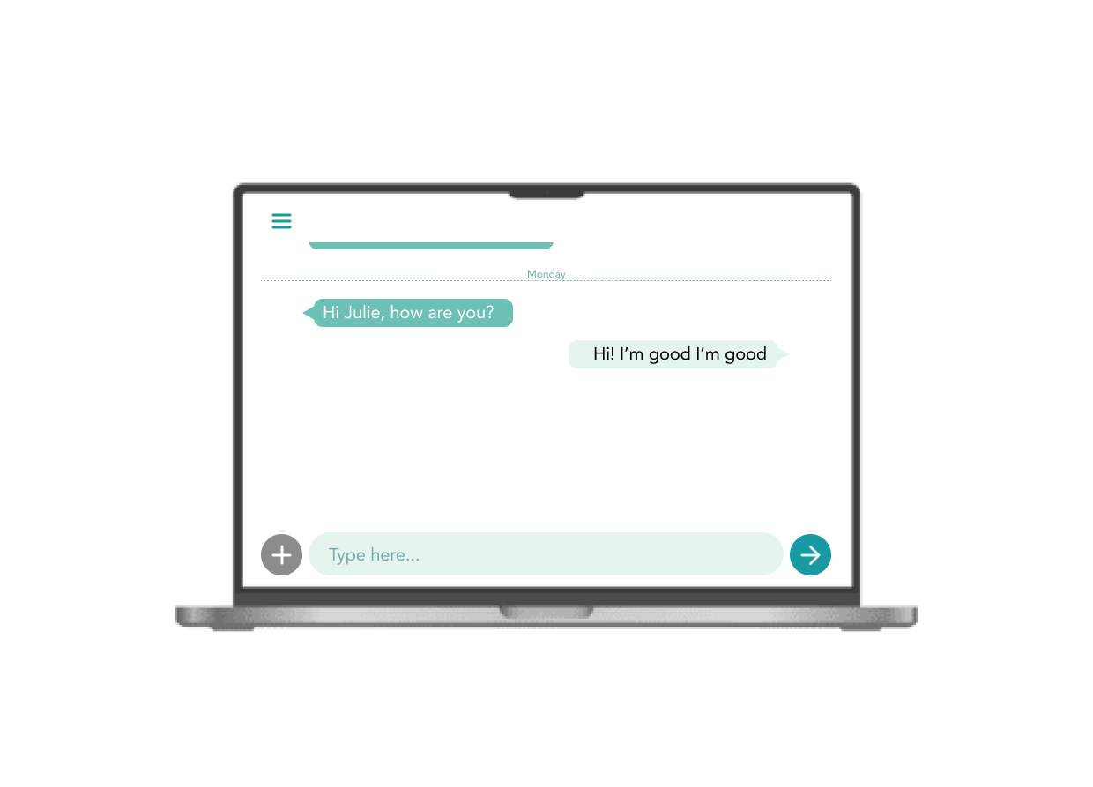

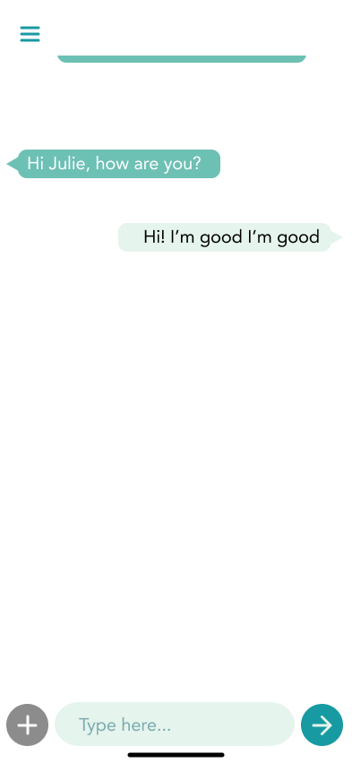
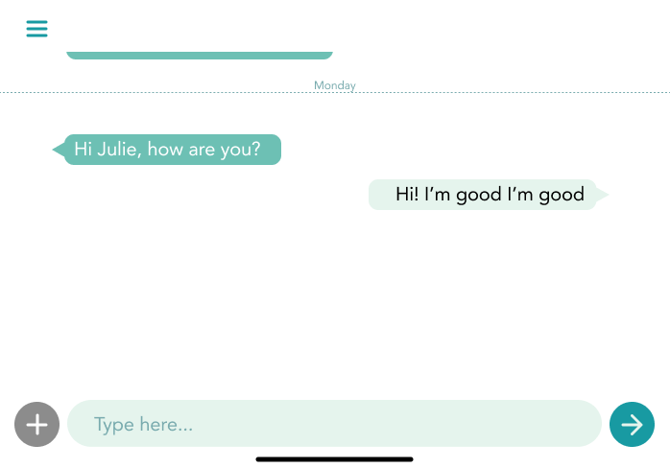
Julie s2241631
Calm Chat
AI-based mental care program
Notes:
Good morning everyone, I’m Julie and thank you for having me here, for an opportunity to present a business idea.

Slide 2
Did you know …
Why?
Problems
Calm Chat
How does it work?
Calm Chat
AI-based mental care program
How does it work? – AI-based
Notes:
The presentation will be given in this order, starting with some background information from research and how the program works.

Slide 3

Did you know…
🌏
The highest suicide rate in the world:
South Korea 🇰🇷
Suicide deaths have risen by 20,000 over past 30 years around the world [Bmj]
“
Most cases:
“
between 9 and 24
Notes:
First of all, I would like you some background information that motivated me to come up with the idea of this program. As living and growing up in Korea, I know how serious issue suicide commitment is across the country. According to the recent data from OECD, suicide rate of South Korea is the highest in the world and the rate is almost double the rate of Japan, rated third highest in the world. More, most of the cases of suicide commitment in Korea happen in the young age group between 9 and 24. Not only in Korea, but suicide rate have also been increasing over time around the world.

Slide 4
Why?
1
Increased medical costs
2
Misunderstandings on psychiatric treatment and its subject – severer mental illness – which make people hesitate to go see a doctor.
3
Hard to find someone to talk about their feelings and personal things.
Notes:
One of the main causes of high suicide rate is increase in medical costs. People are not as affordable as past years for medical treatment. Also, there are misunderstandings on getting psychiatric treatment. It’s often thought that the treatment is needed for the ones with severer mental illness. Last but not least, a lot of people find it hard to get someone to talk and share their personal things and circumstances that make them worried and anxious.

Slide 5

Problems
🏡
💰
👴🏻👵🏻
👴🏻👵🏻
👴🏻👵🏻
Accelerates the problem of ageing population
Loss of main human resource
Low quality of life
Notes:
What would be the problems that would be caused by increasing suicide rate?

Slide 6
Problems
🏡
💰
👴🏻👵🏻
👴🏻👵🏻
👴🏻👵🏻
Accelerates the problem of ageing population
Loss of main human resource
Low quality of life
Notes:
As population aging is another worldwide issue, loss in young age group would accelerate such problem.

Slide 7
Problems
🏡
💰
👴🏻👵🏻
👴🏻👵🏻
👴🏻👵🏻
Accelerates the problem of ageing population
Loss of main human resource
Low quality of life
Notes:
Also, as previously mentioned, high proportion of suicide cases is attributed by young age group. This could lead to loss in potential human resource.

Slide 8
Problems
🏡
💰
👴🏻👵🏻
👴🏻👵🏻
👴🏻👵🏻
Accelerates the problem of ageing population
Loss of main human resource
Low quality of life
Notes:
On top of that, causes of suicide commitments that are often mentioned, such as mental issues because of unbalance between income and inflation, severe depression, and other mental illness. These indicates low quality of life in a country or a society.

Slide 9
Calm Chat
Easy words that reminds mindfulness
💡Idea: people need someone or somewhere to talk to
Many decision on suicide commitment made due to mental illness or depression
Talk like a “Human”
Notes:
Getting idea from the fact that a lot of people decide suicide because of mental illness or depression, I have thought of a business idea, an AI-based program where anyone can have a chat, revealing how they feel, what they are concerned about, and even their mental issues.

Slide 10
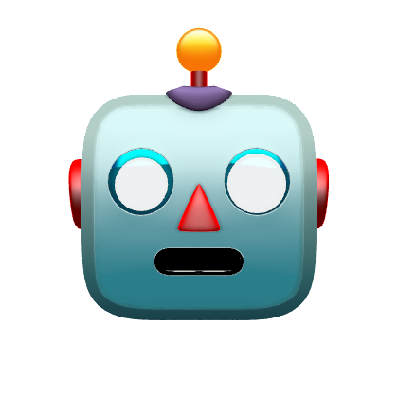
Calm Chat
Treatment needed?
❔
Yes
❓
No
Notes:
Analysing the language and messages the user leave, the programme, learnt psychiatric expertise decide whether the user need diagnosis. When the user is analysed to need a treatment, the programme starts therapy that suits the user. As some cases would require in-person activities or therapy, the program contacts medical facilities and connect the user and the facility.

Slide 11

Calm Chat
Treatment needed?
❔
Yes
💡
❓
No
Notes:
Analysing the language and messages the user leave, the programme, learnt psychiatric expertise decide whether the user need diagnosis. When the user is analysed to need a treatment, the programme starts therapy that suits the user. As some cases would require in-person activities or therapy, the program contacts medical facilities and connect the user and the facility.

Slide 12
Calm Chat
Start therapy
❔
Contact medical facility
💡
❓
Connect User and facility
Notes:
Analysing the language and messages the user leave, the programme, learnt psychiatric expertise decide whether the user need diagnosis. When the user is analysed to need a treatment, the programme starts therapy that suits the user. As some cases would require in-person activities or therapy, the program contacts medical facilities and connect the user and the facility.

Slide 13
How does it work?
Notes:
This is how the program looks like on different devices
Users will see a message from the programme as soon as they open it and can leave any message that would also followed by a reply from the programme.

Slide 14
How does it work?
Phone
Desktop
Tablet

Slide 15
How does it work?
AI-based system
👩🏻‍⚕️👨🏻‍⚕️🧠
🗣️💬🗯️
Knows how to answer questions like human – use of language
The system learns psychiatric expertise
Notes:
Now, looking into how the system is AI-based,

Slide 16
How does it work?
AI-based system
👩🏻‍⚕️👨🏻‍⚕️🧠
🗣️💬🗯️
Knows how to answer questions like human – use of language
The system learns psychiatric expertise

Slide 17
How does it work?
AI-based system
👩🏻‍⚕️👨🏻‍⚕️🧠
🗣️💬🗯️
Knows how to answer questions like human – use of language
The system learns psychiatric expertise
Notes:
The system should learn psychiatric expertise that is needed when the system analyse the user and make a decision for them whether they need a treatment or not.

Slide 18
How does it work?
AI-based system
👩🏻‍⚕️👨🏻‍⚕️🧠
🗣️💬🗯️
Knows how to answer questions like human – use of language
The system learns psychiatric expertise
Notes:
AI-based development of the system will enable chatting like human, in terms of use of language and understanding the context, and make the user feel more comfortable to talk about themselves.

Slide 19
Calm Chat
AI-based mental care program
Notes:
That is it for the the business idea and thank you so much for listening!

